Slide 1
Lecture 7 Measures of Central Tendency 07-08-2023

Slide 2
Measure of central tendency
A measure of central tendency is a single value that attempts to describe a set of data by identifying the central position within that set of data.
As such, measures of central tendency are sometimes called measures of central location.
They are also classed as summary statistics.
The mean (often called the average) is most likely the measure of central tendency that you are most familiar with, but there are others, such as the median and the mode.
The mean, median and mode are all valid measures of central tendency, but under different conditions, some measures of central tendency become more appropriate to use than others. In the following sections, we will look at the mean, mode and median, and learn how to calculate them and under what conditions they are most appropriate to be used.

Slide 3
Measures of central tendency
The mean, median, and mode are measures of central tendency—values that describe the center of a data set.
The mean is the sum of the values in the set divided by the number of values. It is often represented as x.
The median is the middle value or the mean of the two middle values when the set is ordered numerically. The
mode is the value or values that occur most often. A data set may have one mode, no mode, or several modes.

Slide 4
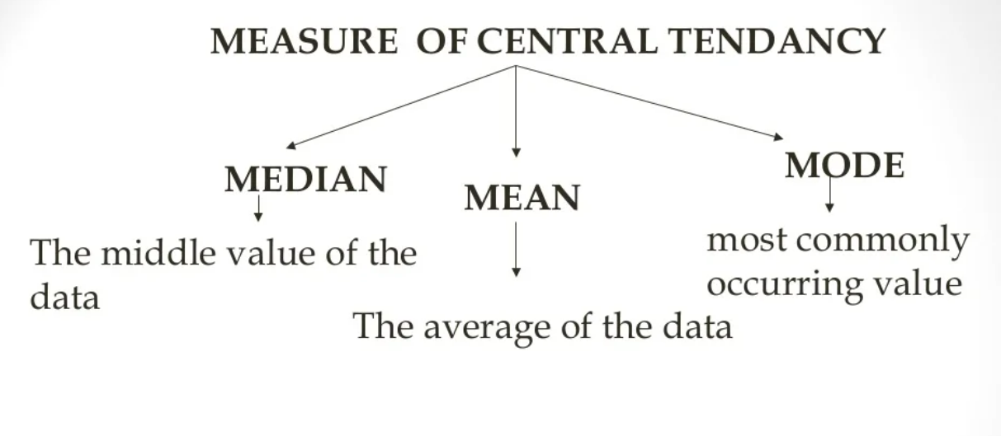

Slide 5



Mean (Arithmetic)
The mean (or average) is the most popular and well known measure of central tendency.
It can be used with both discrete and continuous data.
The mean is equal to the sum of all the values in the data set divided by the number of values in the data set. So, if we have n values in a data set and they have values

Slide 6
Pros of Mean
The mean is essentially a model of your data set. It is the value that is most common.
You will notice, however, that the mean is not often one of the actual values that you have observed in your data set.
However, one of its important properties is that it minimises error in the prediction of any one value in your data set.
That is, it is the value that produces the lowest amount of error from all other values in the data set.
An important property of the mean is that it includes every value in your data set as part of the calculation.
In addition, the mean is the only measure of central tendency where the sum of the deviations of each value from the mean is always zero

Slide 7
Cons of mean
It is particularly susceptible to the influence of outliers. These are values that are unusual compared to the rest of the data set by being especially small or large in numerical value.
Take Example wages of staff at a factory below:
The mean salary for these ten staff is $30.7k. However, inspecting the raw data suggests that this mean value might not be the best way to accurately reflect the typical salary of a worker, as most workers have salaries in the $12k to 18k range.
The mean is being skewed by the two large salaries. Therefore, in this situation, we would like to have a better measure of central tendency. As we will find out later, taking the median would be a better measure of central tendency in this situation

Slide 8
Median
The median is the middle score for a set of data that has been arranged in order of magnitude.
The median is less affected by outliers and skewed data.

Slide 9
Outliers
An outlier is an extreme value that is much less than or much greater than the other data values. Outliers have a strong effect on the mean and standard
deviation. If an outlier is the result of measurement error or represents data from the wrong population, it is usually removed. There are different ways to
determine whether a value is an outlier. One is to look for data values that are more than 3 standard deviations from the mean

Slide 10
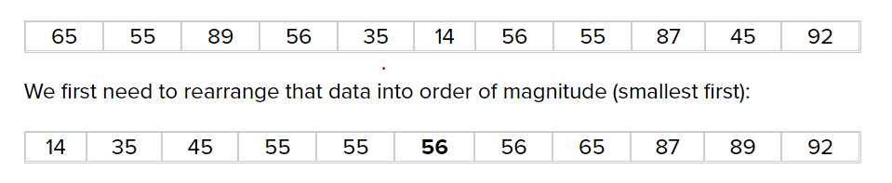
Median
The median is the middle score for a set of data that has been arranged in order of magnitude.
The median is less affected by outliers and skewed data.
Compute Median of following data:

Slide 11
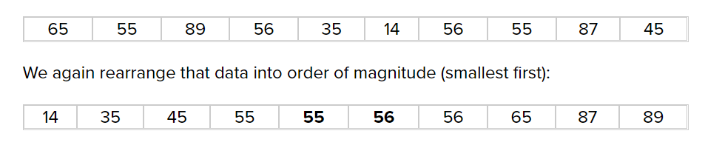
Median Computation continue..
Now take the 5th and 6th score in our data set and average them to get a median of 55.5

Slide 12
Mode
Mode means a value or a number that appears most frequently in a dataset.
Unimodal List: A list of given data with only one mode is called a unimodal list.
Bimodal List: A list of given data with two modes is called a bimodal list

Slide 13
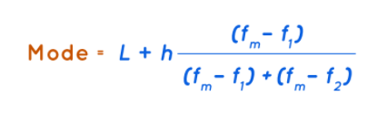
Mode Formula
L is the lower limit of the modal class
h is the size of the class interval
Fm is the frequency of the modal class
f1 is the frequency of the class preceding the modal class
f2is the frequency of the class succeeding the modal class

Slide 14

Example 1: Finding Measures of Central Tendency
Find the mean, median, and mode of the data.
deer at a feeder each hour: 3, 0, 2, 0, 1, 2, 4
Mean:
deer
Median:
0 0 1 2 2 3 4
= 2 deer
Mode:
The most common results are 0 and 2.

Slide 15

Find the mean, median, and mode of the data set.
{2, 5, 6, 2, 6}
Mean:
Median:
2 2 5 6 6
= 5
Mode:
2 and 6

Slide 16
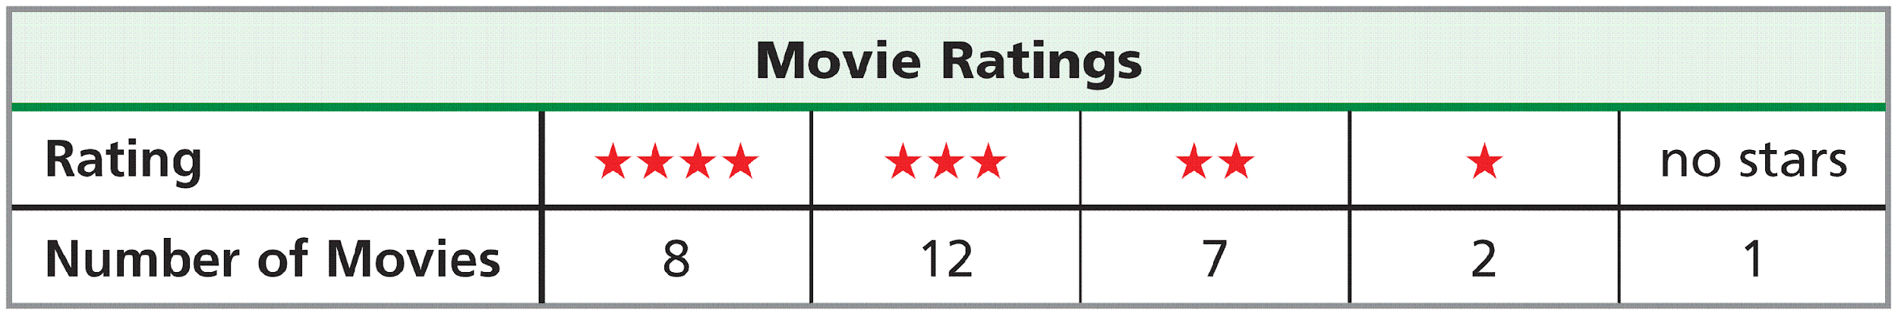

A weighted average is a mean calculated by using frequencies of data values. Suppose that 30 movies are rated as follows:
weighted average of stars =

Slide 17
For numerical data, the weighted average of all of those outcomes is called the expected value for that experiment.
The probability distribution for an experiment is the function that pairs each outcome with its probability.

Slide 18
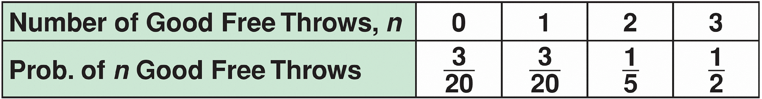
Example 2: Finding Expected Value
The probability distribution of successful free throws for a practice set is given below. Find the expected number of successes for one set.

Slide 19



Example 2 Continued
Use the weighted average.
Simplify.
The expected number of successful free throws is 2.05.

Slide 20
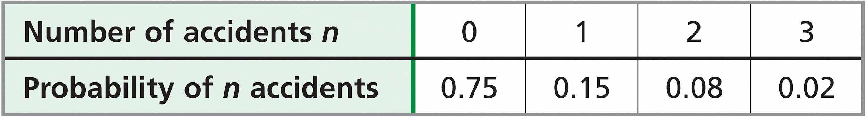
Another Example
The probability distribution of the number of accidents in a week at an intersection, based on past data, is given below. Find the expected number of accidents for one week.
expected value = 0(0.75) + 1(0.15) + 2(0.08) + 3(0.02)
Use the weighted average.
Simplify.
=0.37
The expected number of accidents is 0.37.

Slide 21
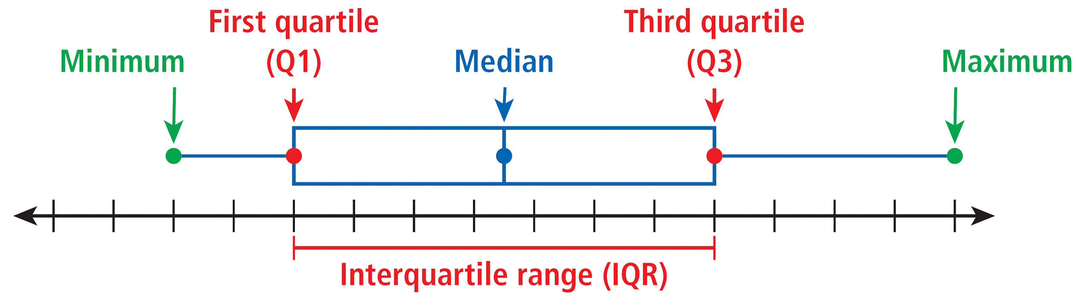
A box-and-whisker plot shows the spread of a data set. It displays 5 key points: the minimum and maximum values, the median, and the first and third quartiles.

Slide 22
The quartiles are the medians of the lower and upper halves of the data set. If there are an odd number of data values, do not include the median in either half.
The interquartile range, or IQR, is the difference between the 1st and 3rd quartiles, or Q3 – Q1. It represents the middle 50% of the data.

Slide 23
Example 3: Making a Box-and-Whisker Plot and Finding the Interquartile Range
Make a box-and-whisker plot of the data. Find the interquartile range.
{6, 8, 7, 5, 10, 6, 9, 8, 4}
Step 1 Order the data from least to greatest.
4, 5, 6, 6, 7, 8, 8, 9, 10
Step 2 Find the minimum, maximum, median, and quartiles.
4, 5, 6, 6, 7, 8, 8, 9, 10
Mimimum
Median
Maximum
First quartile
5.5
Third quartile
8.5

Slide 24
Example 3 Continued
Step 3 Draw a box-and-whisker plot.
Draw a number line, and plot a point above each of the five values. Then draw a box from the first quartile to the third quartile with a line segment through the median. Draw whiskers from the box to the minimum and maximum.

Slide 25
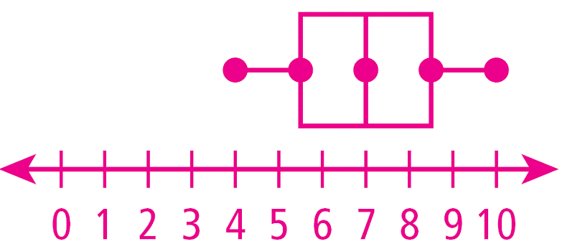
Example 3 Continued
IRQ = 8.5 – 5.5 = 3
The interquartile range is 3, the length of the box in the diagram.

Slide 26
Example 3
Make a box-and-whisker plot of the data. Find the interquartile range. {13, 14, 18, 13, 12, 17, 15, 12, 13, 19, 11, 14, 14, 18, 22, 23}
Step 1 Order the data from least to greatest.
11, 12, 12, 13, 13, 13, 14, 14, 14, 15, 17, 18, 18, 19, 22, 23
Step 2 Find the minimum, maximum, median, and quartiles.
11, 12, 12, 13, 13, 13, 14, 14, 14, 15, 17, 18, 18, 19, 22, 23
Mimimum
Median
Maximum
First quartile 13
Third quartile
18

Slide 27
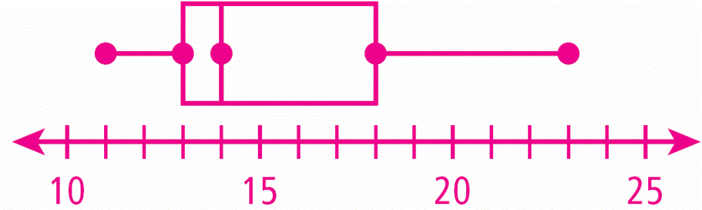
Example 3 Continued
Step 3 Draw a box-and-whisker plot.
IQR = 18 – 13 = 5
The interquartile range is 5, the length of the box in the diagram.

Slide 28
The data sets {19, 20, 21} and {0, 20, 40} have the same mean and median, but the sets are very different. The way that data are spread out from the mean or median is important in the study of statistics.

Slide 29
A measure of Variation
A measure of variation is a value that describes the spread of a data set.
The most commonly used measures of variation are the range, the interquartile range, the variance, and the standard deviation.

Slide 30
The variance, denoted by σ², is the average of the squared differences from the mean.
Standard deviation, denoted by σ, is the square root of the variance and is one of the most common and useful measures of variation.

Slide 31
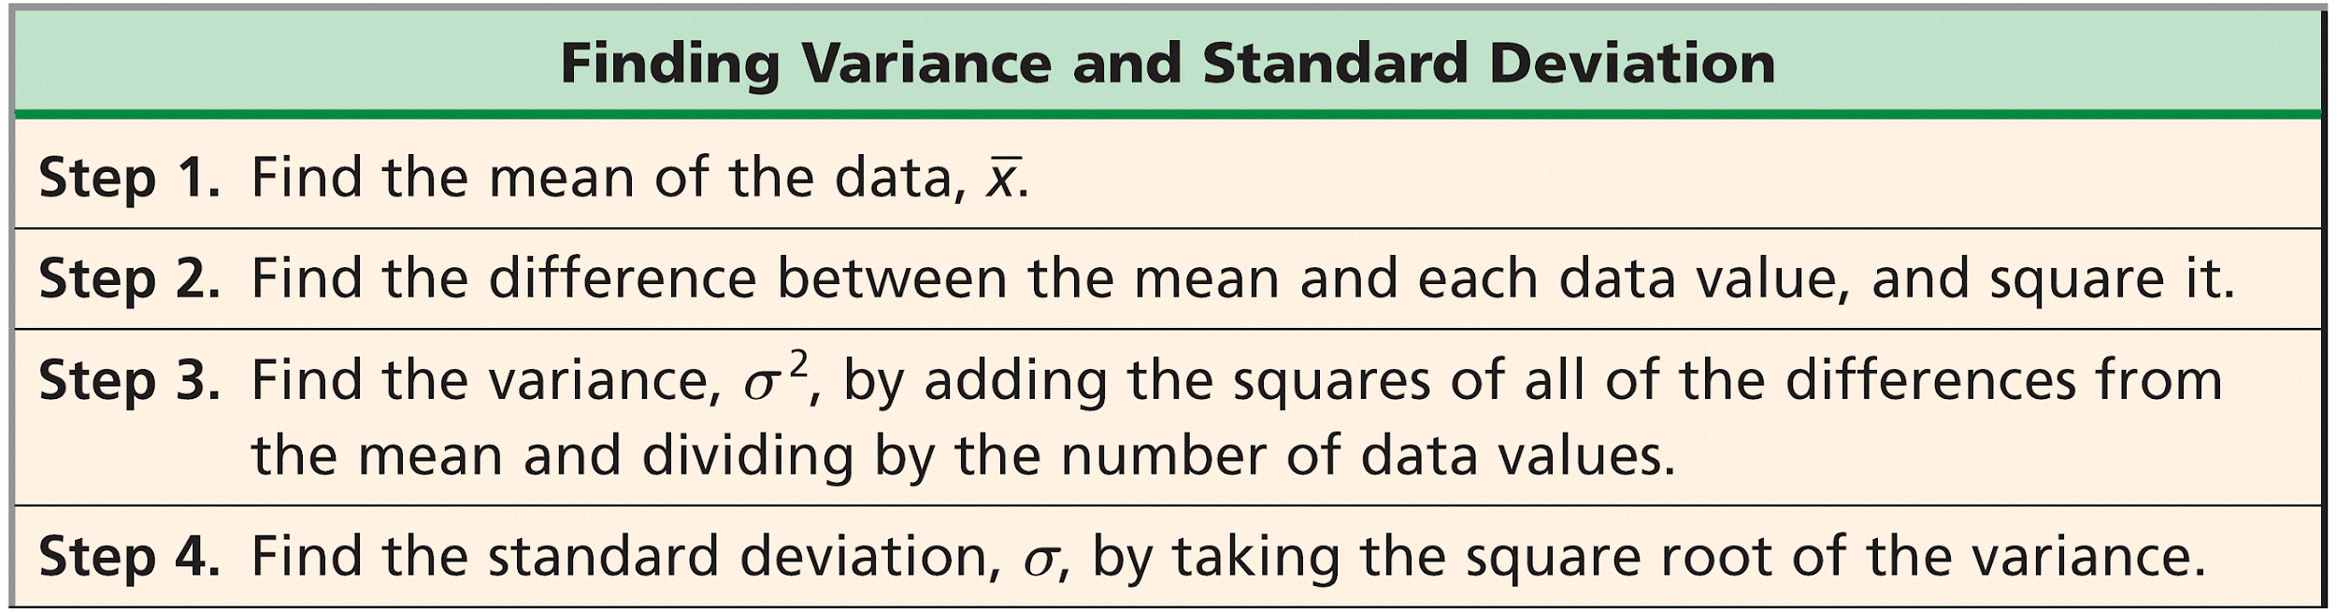
Low standard deviations indicate data that are clustered near the measures of central tendency, whereas high standard deviations indicate data that are spread out from the center.

Slide 32

Example 4: Finding the Mean and Standard Deviation
Find the mean and standard deviation for the data set of the number of people getting on and off a bus for several stops.
{6, 8, 7, 5, 10, 6, 9, 8, 4}
Step 1 Find the mean.

Slide 33
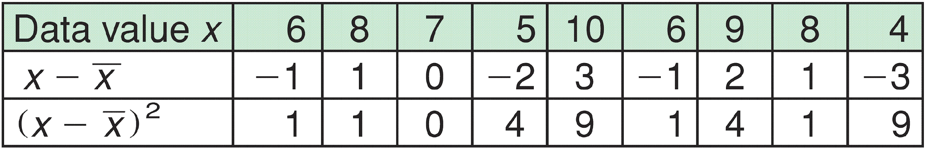
Example 4 Continued
Step 2 Find the difference between the mean and each data value, and square it.

Slide 34

Find the mean and standard deviation for the data set of the number of elevator stops for several rides.
{0, 3, 1, 1, 0, 5, 1, 0, 3, 0}
Step 1 Find the mean.

Slide 35
Step 2 Find the difference between the mean and each data value, and square it.
Data Value x | 0 | 3 | 1 | 1 | 0 | 5 | 1 | 0 | 3 | 0
x – x | -1.4 | 1.6 | -0.4 | -0.4 | -1.4 | 3.6 | -0.4 | -1.4 | 1.6 | -1.4
(x – x)² | 1.96 | 2.56 | 0.16 | 0.16 | 1.96 | 12.96 | 0.16 | 1.96 | 2.56 | 1.96

Slide 36


Step 3 Find the variance.
Find the average of the last row of the table
Step 4 Find the standard deviation.
The standard deviation is the square root of the variance.
The mean is 1.4 stops and the standard deviation is about 1.6 stops.

